Slide 1

React
List, Event, State

Slide 2
# Table of Contents
Refactor
List and Keys
Handling Event
State

Slide 3
React Developer Tools

Slide 4
# React Developer Tools
Debugging Tools for React.
Inspect React Component Hierarchies.
Inspect and edit: Component, Element, Props, State
Install: Link

Slide 5
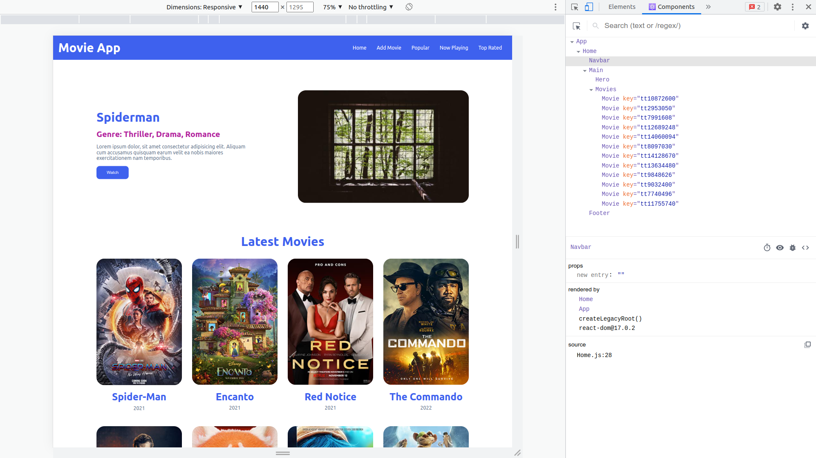

Slide 6
Refactor

Slide 7
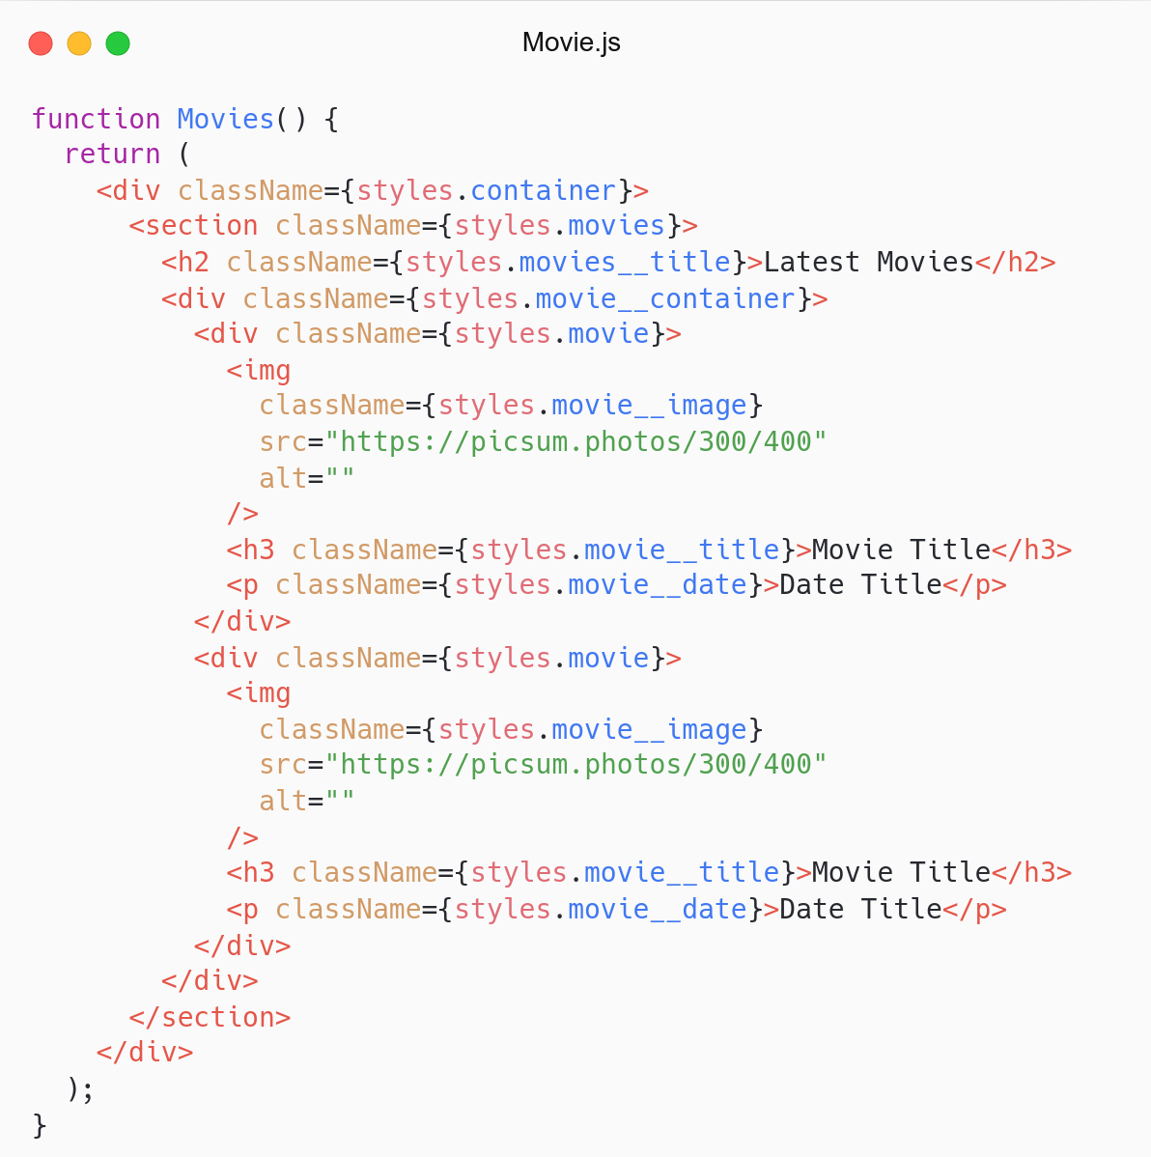
Remember Thinking in React
Can we break into smaller component?
Movie Component.

Slide 8
# Movie Component
Membuat Movie Component (single movie).
Simpan di folder src/components/Movie/.
Component: Movie.js.
CSS: Movie.module.css.
Referensi: React- Thinking in React.

Slide 9
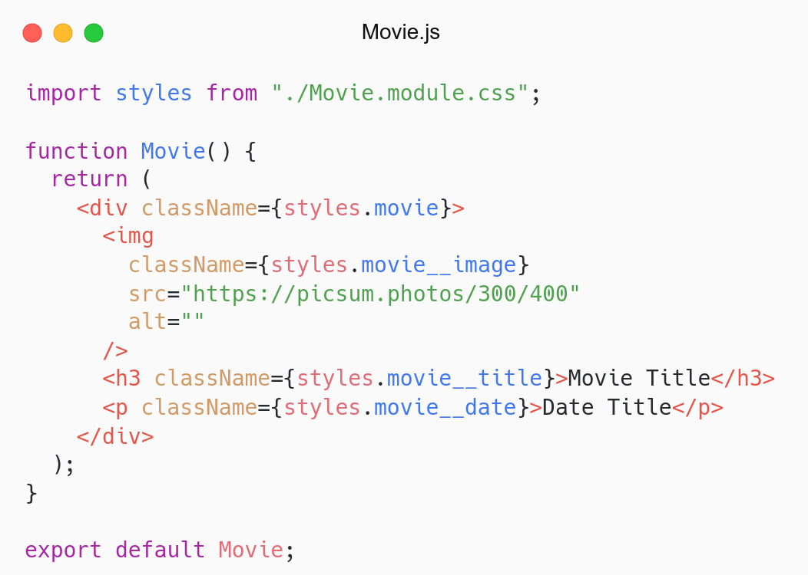
Movie Component

Slide 10
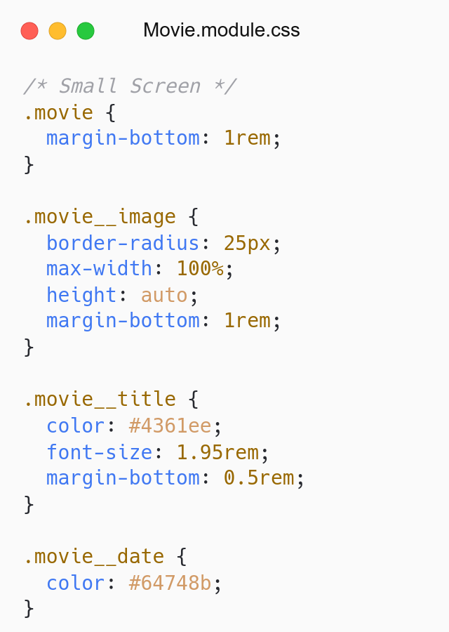
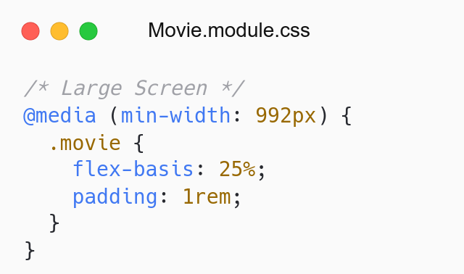
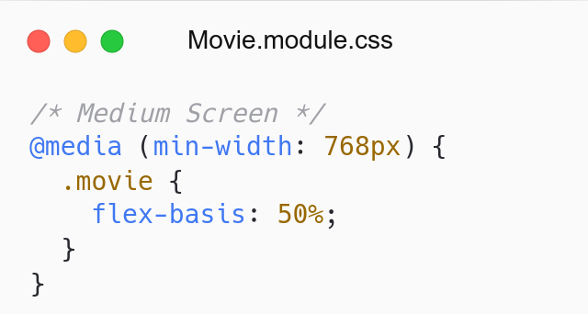
Small Screen
Medium Screen
Large Screen

Slide 11
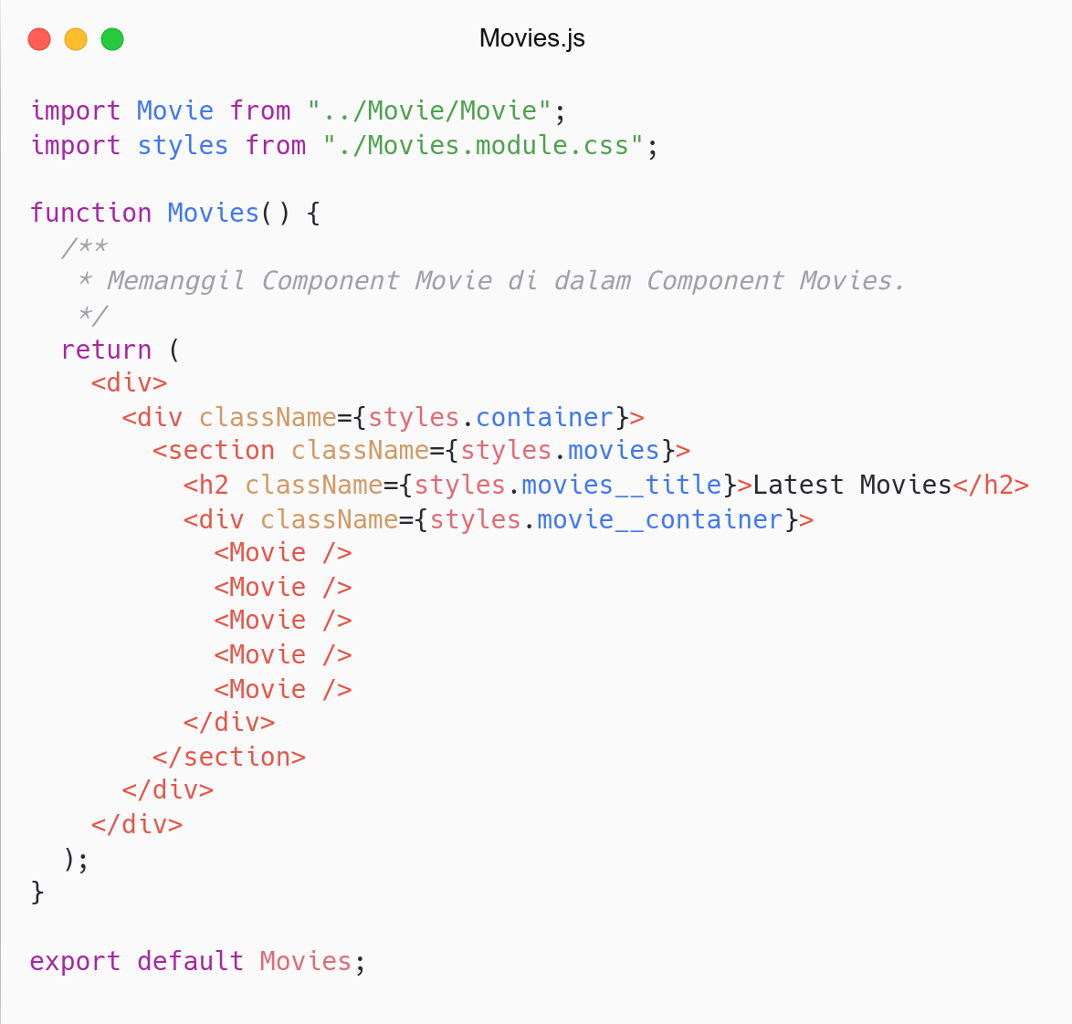
Movies component looks cleaner, right?
Break Large into Small Component.
Movie Component (Single Component).

Slide 12
List and Keys

Slide 13
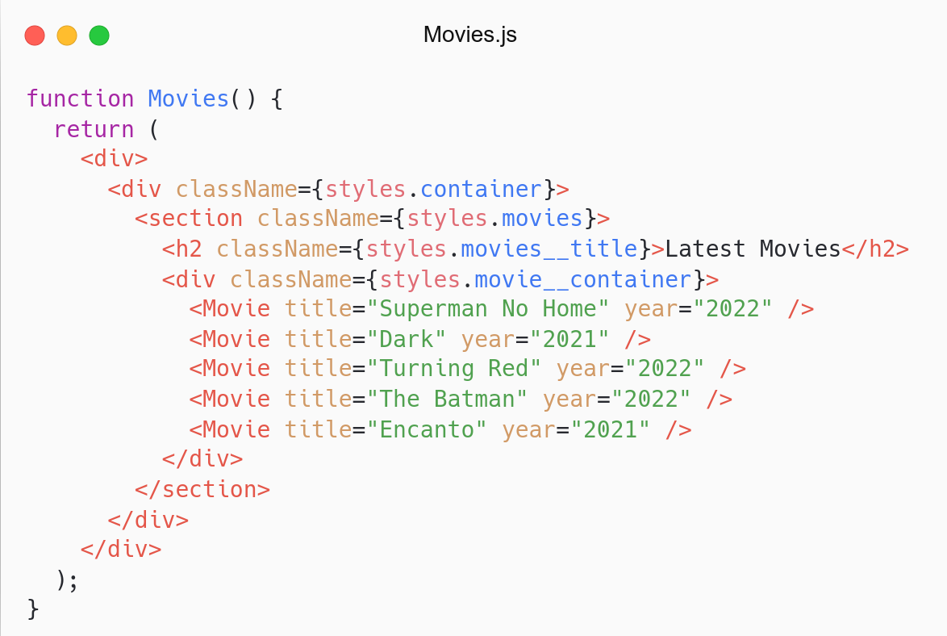
Why don’t create data (movies)?
Looping data and render component.
Send props to component.

Slide 14
# Data Movie
Menyiapkan data movies.
Simpan di folder src/utils/constants/.
File: data.js.
Grab data movies: Link.

Slide 15
# Lists
Render multiple components/elements (list).
Menggunakan array method: map.
Method map mengembalikan array baru (return).
Referensi: React- List and Keys.

Slide 16
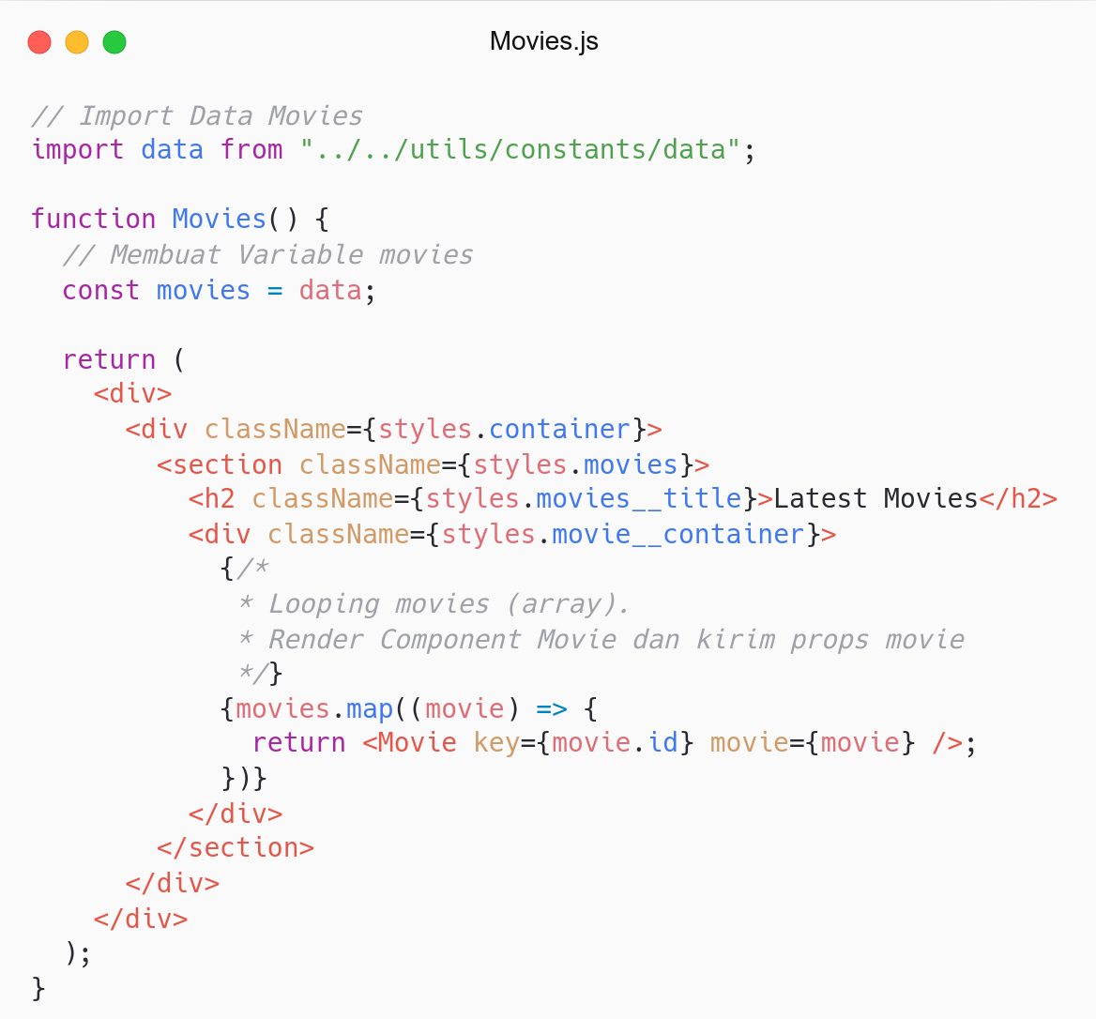

Slide 17
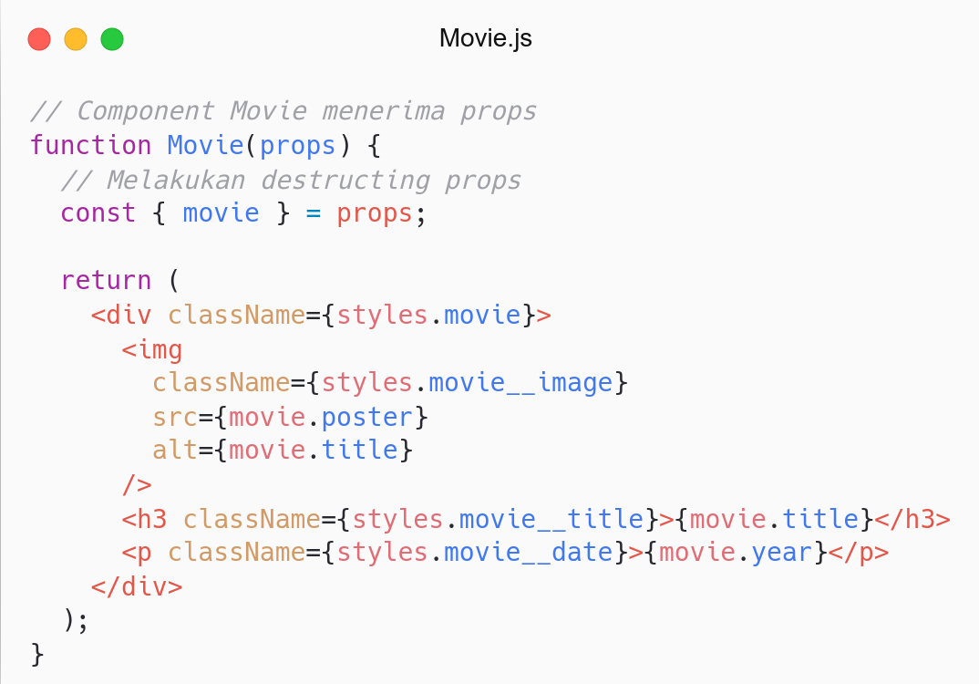
More abstraction.
One component one responsibility.
Looks cleaner

Slide 18
# Keys
Mengidentifikasi component (changeable).
Bersifat unik: id.
Diberikan pada Component yang di-looping.
Referensi: React- List and Keys.

Slide 19
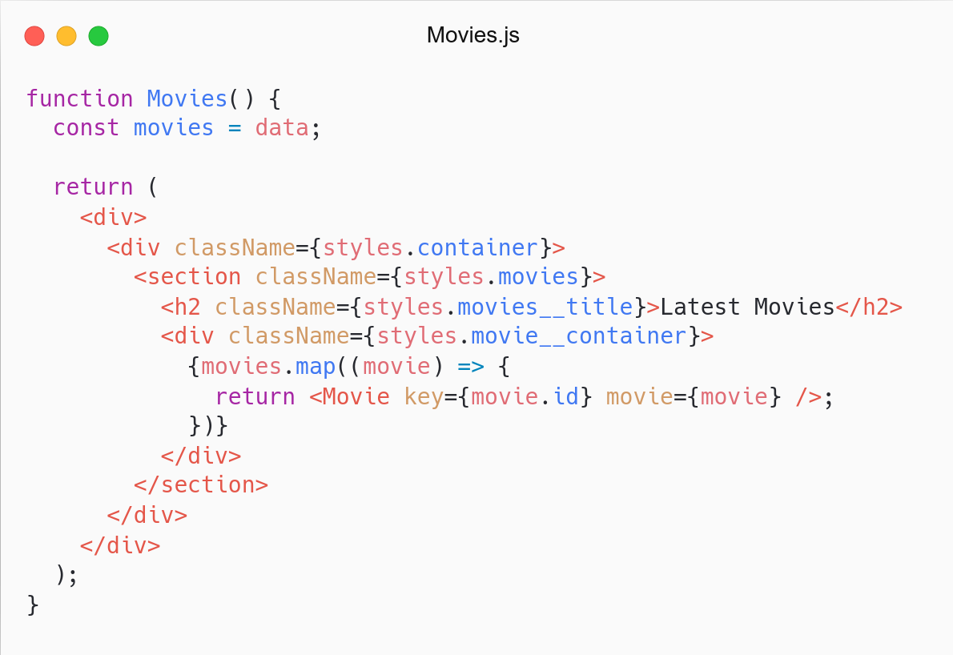
Menambahkan key
Menggunakan ID movie sebagai nilai key

Slide 20
Handling Event

Slide 21
# Event
Action (kejadian) yang terjadi pada Component.
Component bereaksi terhadap kejadian tersebut.
Ex: Jika tombol diklik, maka tampilkan navbar.
Demo: Link.
Referensi: React- Event.

Slide 22
# Event
Common Event (React):
onClick: Component diklik.
onSubmit: Component di-submit (form).
onChange: Component berubah (input).
Referensi: React- Event.

Slide 23
# Handling Event
Handling event in React and JavaScript is bit different.
JavaScript: external event (addEventListener)
React: inline event (onClick)
Difference:
React event is camelCase.
Pass a function in event handler (not string).
Use preventDefault to prevent default behaviour.
Referensi: React- Handling Event.

Slide 24
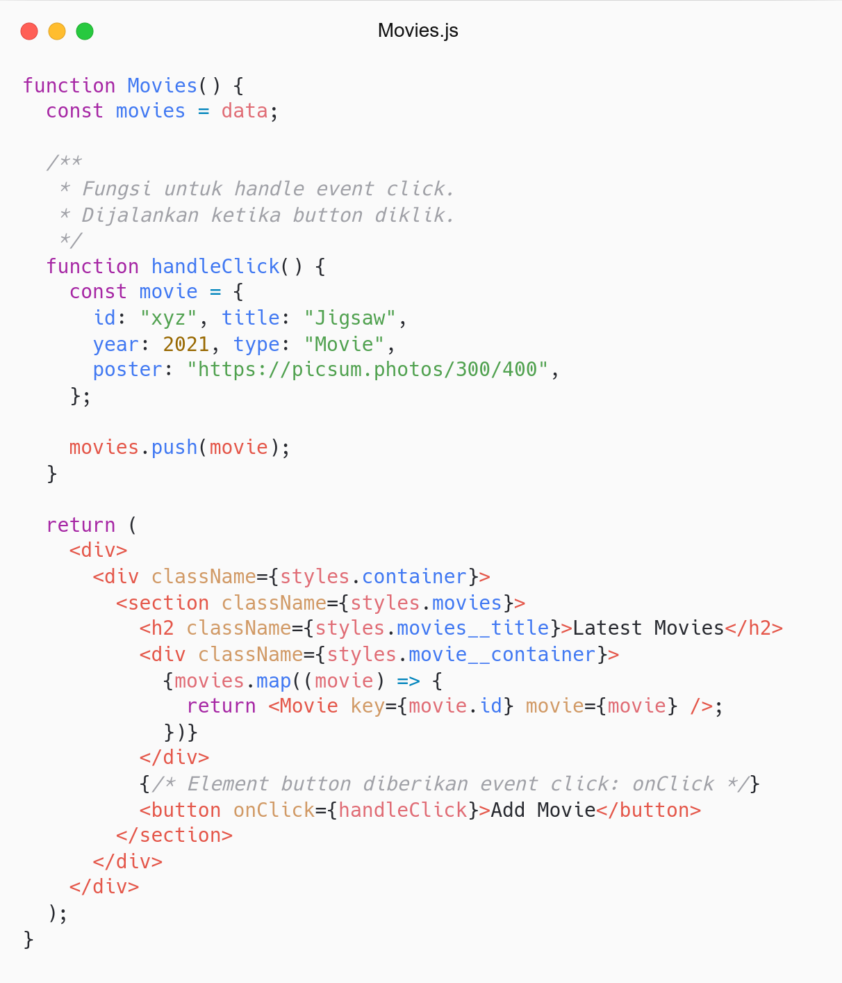
Apakah datanya muncul di Component? Why?
Try log the movies. Apakah muncul?

Slide 25
State

Slide 26
# State
State similar to props.
Make component alive.
Component re-render if state changes
Private and controlled by Component.
Demo: Link.
Referensi: React- State and Lifecycle.

Slide 27
# Handling State
Class Component
Function Component: Hooks State
Why not Class Component:
Complex, hard to understand
Hard to reuse logic
Confuse both people and machines
Referensi: React- State and Lifecycle.

Slide 28
# State Hooks
Hooks: Fungsi spesial untuk menggunakan fitur React (Class Component).
State Hooks: Menambahkan State di Function Component.
New Feature in React 16.8.
Use state without Class.
Only works inside Function.
Referensi: React- State Hooks.

Slide 29
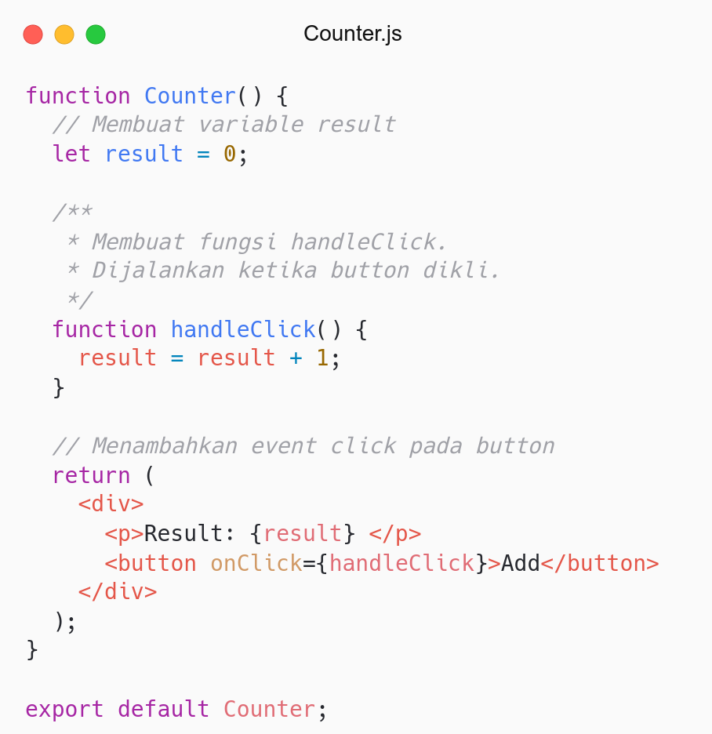
Apakah datanya berubah di component? Why?
Try log the result.
Solution: State.

Slide 30
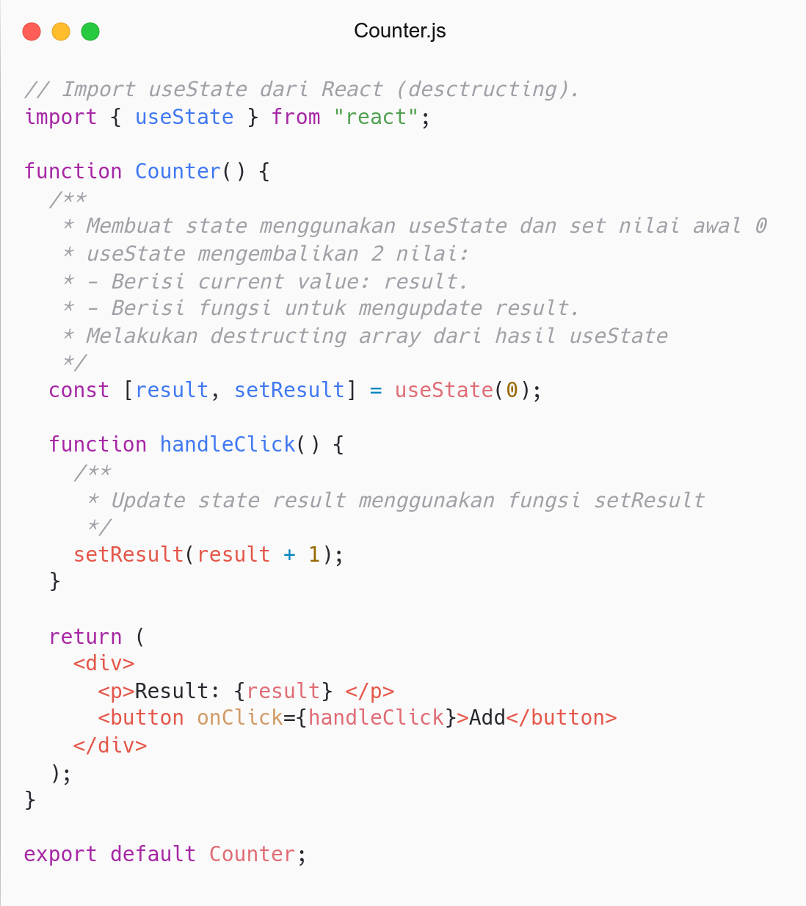
Apakah datanya berubah di Component? Why?
Component re-rendered if state changes
Make component alive

Slide 31
# State - Movie App
Implement state in Movie App
Use useState to create state movies.
Update state when button click.
Referensi: React- State Hooks.

Slide 32
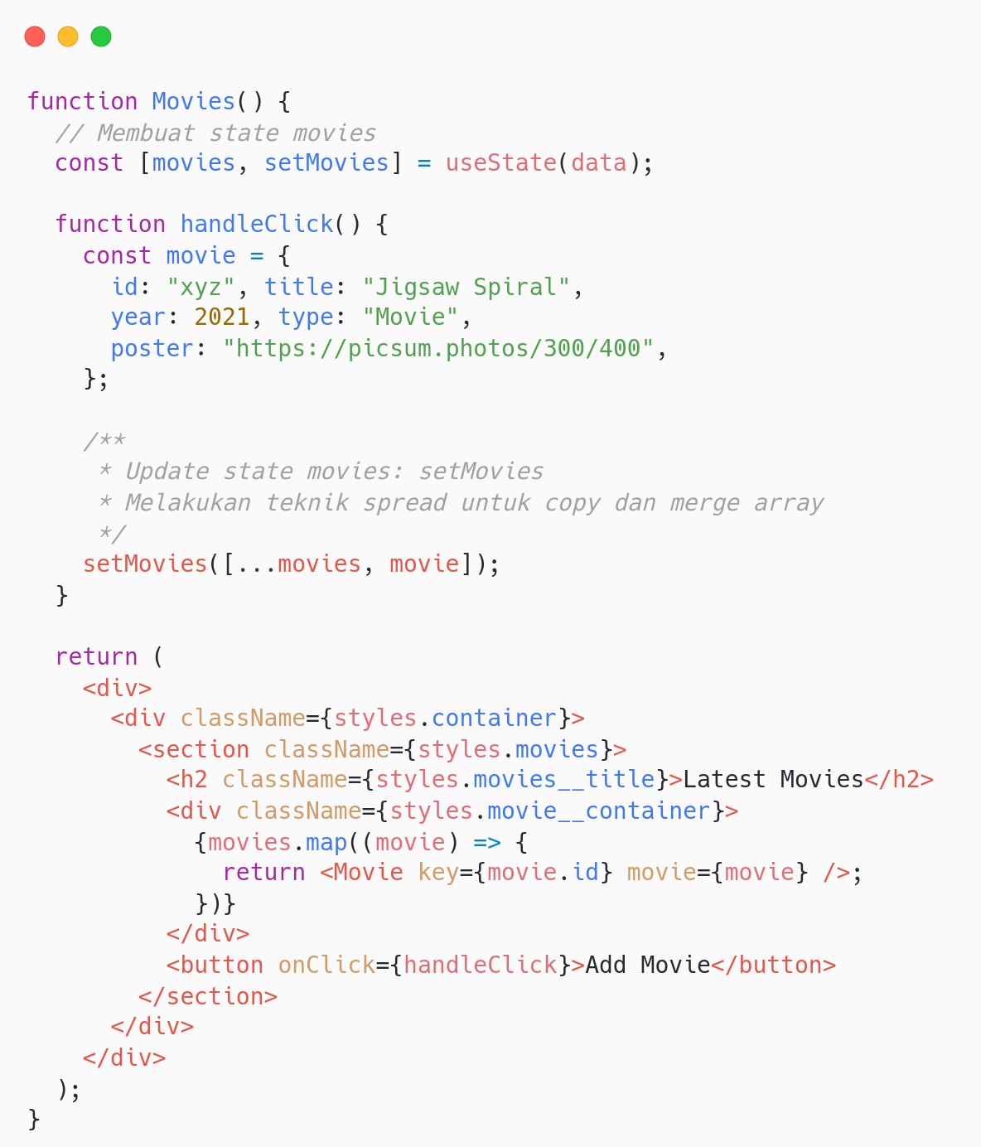
Masih ingat spread operator?
Menggunakan operator three dots: …
Digunakan untuk copy dan merge array

Slide 33
Generate ID

Slide 34
# Generate ID
Generate ID unik.
Menggunakan package nanoid.
Install: npm i nanoid.
Referensi: React- State Hooks.

Slide 35
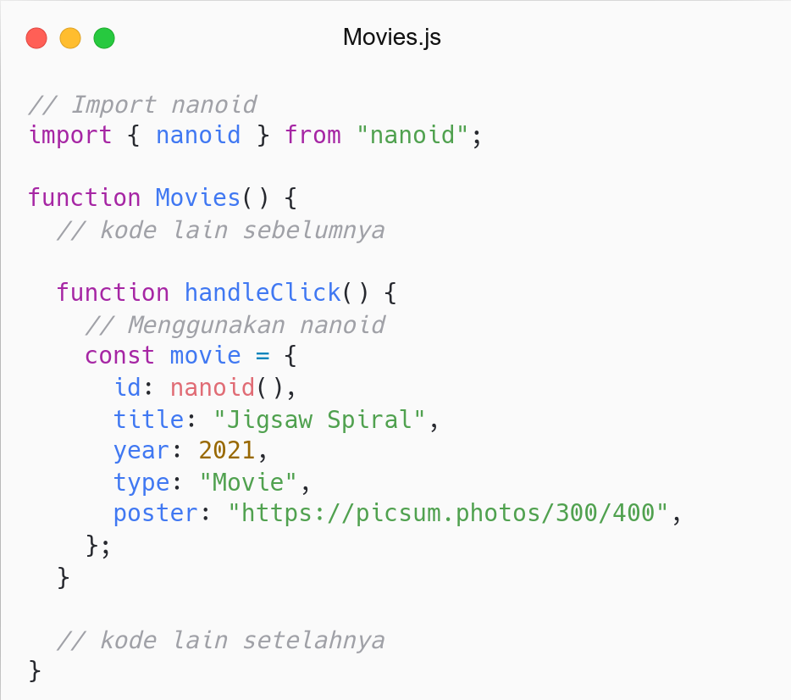

Slide 36
Recap

Slide 37
# Recap
JSX: Menulis UI (HTML) di React.
Component: Reusable UI, tersusun oleh element(s).
Props: Input pada Component.
State: Private Data pada Component.
List and Keys: Render multiple Components.
Event: Action yang terjadi pada Component.

Slide 38
QnA

Slide 39
Take Away

Slide 40
# Task
Description:
Push your work to Github.
Assignment:
Push code to Repository Github (use branch for task management).
No zip and don’t push node_nodules folder.
Submit link repository to elena.
Kamis: 31 Maret 2022, Link Elena.
Jumat: 01 April 2022, Link Elena.

Slide 41
Attendance

Slide 42
Thanks

